Slide 1
ИИ в медицине: типы решаемых задач, архитектуры и технические особенности
Гараева Алина 302

Slide 2
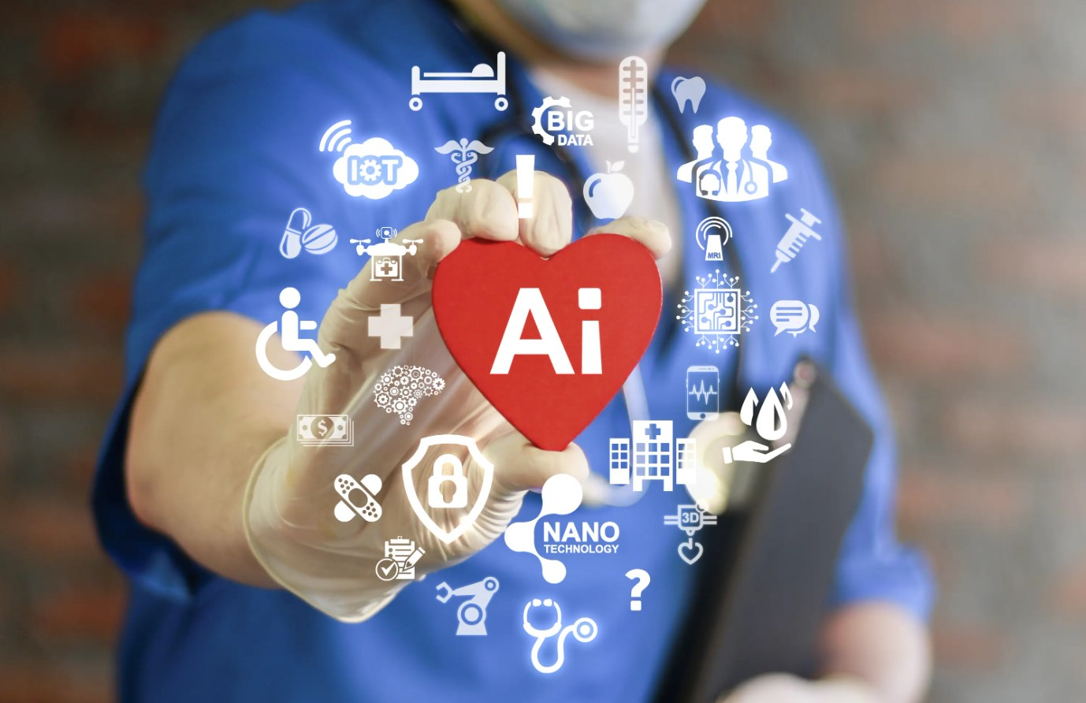
Классы данных
изображения;
временные ряды и электронные медицинские карты (ЭМК);
текст;
мультимодальные данные.
[1] Litjens G., Kooi T., Bejnordi B. E., Setio A. A. A., Ciompi F., Ghafoorian M., van der Laak J. A. W. M., van Ginneken B., Sánchez C. I. A survey on deep learning in medical image analysis // Medical Image Analysis. 2017. Vol. 42. P. 60–88. URL: https://www.sciencedirect.com/science/article/pii/S1361841517301135 [2] Shen D., Wu G., Suk H.-I. Deep Learning in Medical Image Analysis // Annual Review of Biomedical Engineering. 2017. Vol. 19. P. 221–248. URL: https://pmc.ncbi.nlm.nih.gov/articles/PMC5479722/

Slide 3
1.1 Классификация
Примеры
Классификация
рентгеновского снимка на «норма/патология»;
дерматоскопического изображения на «доброкачественное/злокачественное образование»;
ЭКГ на «есть/нет аритмии»;
клиничесуого теста на «содержит/не содержит признак заболевания».
Методы и архитектуры
Классические алгоритмы (логистическая ререссия, метод опорных векторов, случайный лес);
Сверточные нейронный сети (архитектуры Resnet, DenseNet, EfficientNet);
Transformers
[1] Litjens G., Kooi T., Bejnordi B. E., Setio A. A. A., Ciompi F., Ghafoorian M., van der Laak J. A. W. M., van Ginneken B., Sánchez C. I. A survey on deep learning in medical image analysis // Medical Image Analysis. 2017. Vol. 42. P. 60–88. URL: https://www.sciencedirect.com/science/article/pii/S1361841517301135 [2] Shen D., Wu G., Suk H.-I. Deep Learning in Medical Image Analysis // Annual Review of Biomedical Engineering. 2017. Vol. 19. P. 221–248. URL: https://pmc.ncbi.nlm.nih.gov/articles/PMC5479722/ [3] LeCun Y., Bottou L., Bengio Y., Haffner P. Gradient-Based Learning Applied to Document Recognition // Proceedings of the IEEE. 1998. Vol. 86, No. 11. P. 2278–2324. URL: https://vision.stanford.edu/cs598_spring07/papers/Lecun98.pdf [4] Dosovitskiy A., Beyer L., Kolesnikov A. et al. An Image Is Worth 16x16 Words: Transformers for Image Recognition at Scale // International Conference on Learning Representations (ICLR). 2021. URL: https://arxiv.org/abs/2010.11929 [5] Aburass S., Moulahcene M., Albaroudi H. et al. Vision Transformers in Medical Imaging: a Comprehensive Review of Advancements and Applications Across Multiple Diseases // BioMedical Engineering OnLine. 2025. URL: https://pmc.ncbi.nlm.nih.gov/articles/PMC12701147/

Slide 4
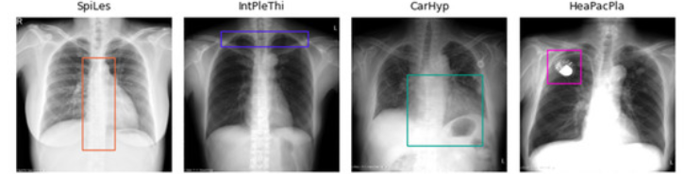
1.2 Детекция и локализация
Примеры
Указать, где именно находится
узел в легком;
полип на эндоскопичском изображении;
очаг кровоизлияния;
патологический учатсок на гистолоническом изображении;
Методы и архитектуры
Двухэтапные детекторы (Faster R-CNN)
Одноэтапные детекторы (семейство YOLO);
RetinaNet(focal loss)
[1] Litjens G., Kooi T., Bejnordi B. E., Setio A. A. A., Ciompi F., Ghafoorian M., van der Laak J. A. W. M., van Ginneken B., Sánchez C. I. A survey on deep learning in medical image analysis // Medical Image Analysis. 2017. Vol. 42. P. 60–88. URL: https://www.sciencedirect.com/science/article/pii/S1361841517301135
[6] Albuquerque C., Henriques J., Cardoso J. S. Deep learning-based object detection algorithms in medical images: a survey // Heliyon. 2025. Vol. 11. URL: https://pmc.ncbi.nlm.nih.gov/articles/PMC11699422/ [7] Ren S., He K., Girshick R., Sun J. Faster R-CNN: Towards Real-Time Object Detection with Region Proposal Networks // Advances in Neural Information Processing Systems. 2015. URL: https://arxiv.org/abs/1506.01497 [8] Redmon J., Divvala S., Girshick R., Farhadi A. You Only Look Once: Unified, Real-Time Object Detection // Proceedings of the IEEE Conference on Computer Vision and Pattern Recognition. 2016. P. 779–788. URL: https://arxiv.org/abs/1506.02640 [9] Lin T.-Y., Goyal P., Girshick R., He K., Dollár P. Focal Loss for Dense Object Detection // Proceedings of the IEEE International Conference on Computer Vision. 2017. P. 2980–2988. URL: https://arxiv.org/abs/1708.02002

Slide 5
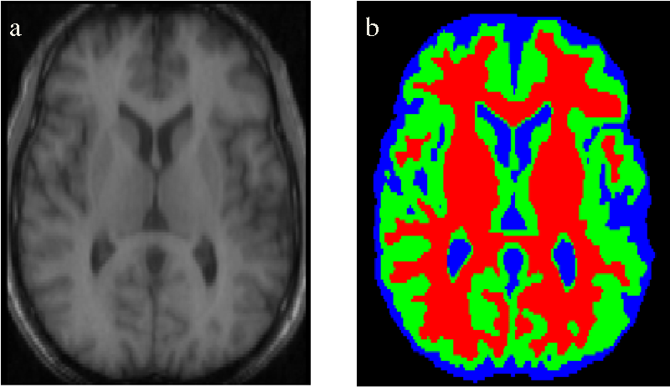
1.3 Сегментация
Примеры
Выделить
опухоль;
орган;
сосуд;
клетки.
Методы и архитектуры
U-Net
3D U-Net
Attention U-Net; Residual U-Net, Nested U-Net
nnU-Net
Transdormer-based segmentation (TransUnet, Swin-UNETR)
[1] Litjens G., Kooi T., Bejnordi B. E., Setio A. A. A., Ciompi F., Ghafoorian M., van der Laak J. A. W. M., van Ginneken B., Sánchez C. I. A survey on deep learning in medical image analysis // Medical Image Analysis. 2017. Vol. 42. P. 60–88. URL: https://www.sciencedirect.com/science/article/pii/S1361841517301135
[5] Aburass S., Moulahcene M., Albaroudi H. et al. Vision Transformers in Medical Imaging: a Comprehensive Review of Advancements and Applications Across Multiple Diseases // BioMedical Engineering OnLine. 2025. URL: https://pmc.ncbi.nlm.nih.gov/articles/PMC12701147/
[10] Ronneberger O., Fischer P., Brox T. U-Net: Convolutional Networks for Biomedical Image Segmentation // Medical Image Computing and Computer-Assisted Intervention (MICCAI). 2015. P. 234–241. URL: https://arxiv.org/abs/1505.04597 [11] Çiçek Ö., Abdulkadir A., Lienkamp S. S., Brox T., Ronneberger O. 3D U-Net: Learning Dense Volumetric Segmentation from Sparse Annotation // Medical Image Computing and Computer-Assisted Intervention (MICCAI). 2016. P. 424–432. URL: https://arxiv.org/abs/1606.06650 [12] Oktay O., Schlemper J., Le Folgoc L. et al. Attention U-Net: Learning Where to Look for the Pancreas // arXiv. 2018. URL: https://arxiv.org/abs/1804.03999 [13] Isensee F., Jaeger P. F., Kohl S. A. A., Petersen J., Maier-Hein K. H. nnU-Net: a self-configuring method for deep learning-based biomedical image segmentation // Nature Methods. 2021. Vol. 18. P. 203–211. URL: https://www.nature.com/articles/s41592-020-01008-z

Slide 6
1.4 Прогнозирование по временным данным и ЭМК
Примеры
Предсказать риск
сепсиса;
повторной госпитализации;
летальности;
сердечно-сосудистого осложнения.
Методы и архитектуры
Логистическая регресси, градиентный бустинг и др.;
RNN, LSTM, GPU;
Transformers
GNN
[14] Boll H. O., Lenssen N., Constantinou S. et al. Graph neural networks for clinical risk prediction based on electronic health records: a review // Journal of Biomedical Informatics. 2024. Vol. 152. URL: https://www.sciencedirect.com/science/article/pii/S1532046424000340 [15] Cho H. N., Jun T. J., Kim Y. H. et al. Task-Specific Transformer-Based Language Models in Health Care: Scoping Review // JMIR Medical Informatics. 2024. Vol. 12. e49724. URL: https://medinform.jmir.org/2024/1/e49724

Slide 7
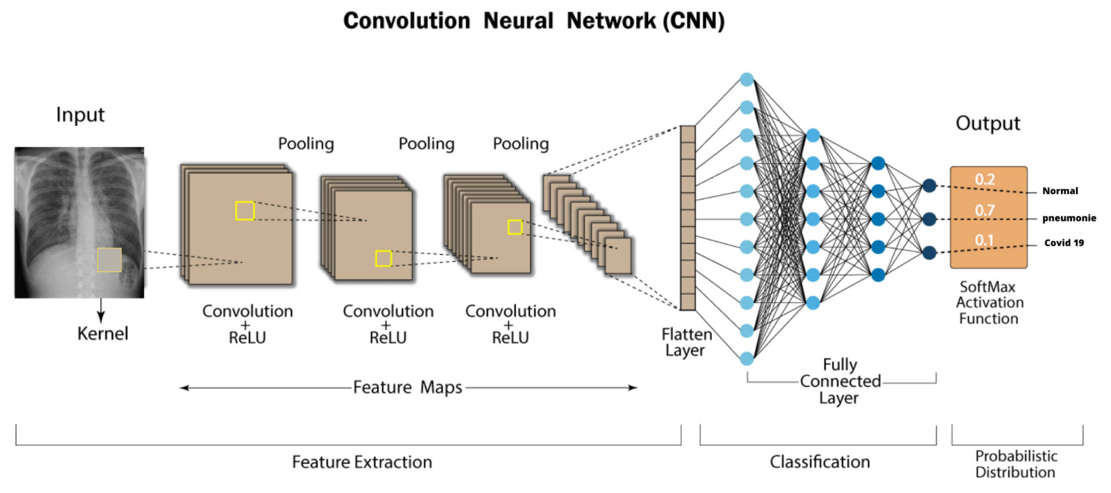
2.1 CNN
[1] Litjens G., Kooi T., Bejnordi B. E., Setio A. A. A., Ciompi F., Ghafoorian M., van der Laak J. A. W. M., van Ginneken B., Sánchez C. I. A survey on deep learning in medical image analysis // Medical Image Analysis. 2017. Vol. 42. P. 60–88. URL: https://www.sciencedirect.com/science/article/pii/S1361841517301135 [3] LeCun Y., Bottou L., Bengio Y., Haffner P. Gradient-Based Learning Applied to Document Recognition // Proceedings of the IEEE. 1998. Vol. 86, No. 11. P. 2278–2324. URL: https://vision.stanford.edu/cs598_spring07/papers/Lecun98.pdf

Slide 8
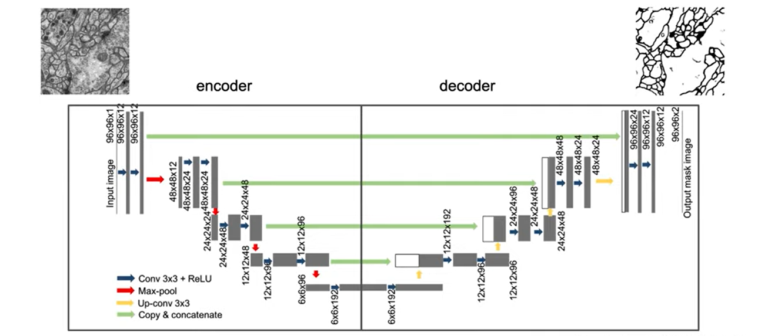
2.2 U-Net
[10] Ronneberger O., Fischer P., Brox T. U-Net: Convolutional Networks for Biomedical Image Segmentation // Medical Image Computing and Computer-Assisted Intervention (MICCAI). 2015. P. 234–241. URL: https://arxiv.org/abs/1505.04597

Slide 9
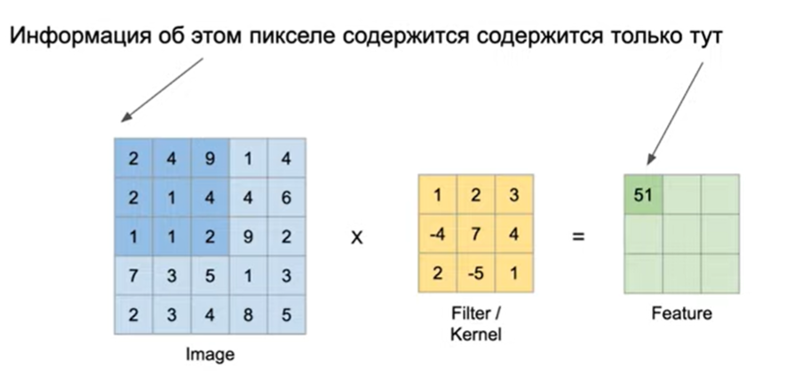
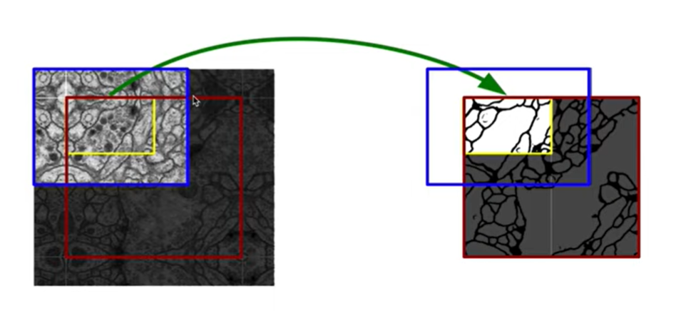
Overlap-tile strategy
[10] Ronneberger O., Fischer P., Brox T. U-Net: Convolutional Networks for Biomedical Image Segmentation // Medical Image Computing and Computer-Assisted Intervention (MICCAI). 2015. P. 234–241. URL: https://arxiv.org/abs/1505.04597

Slide 10
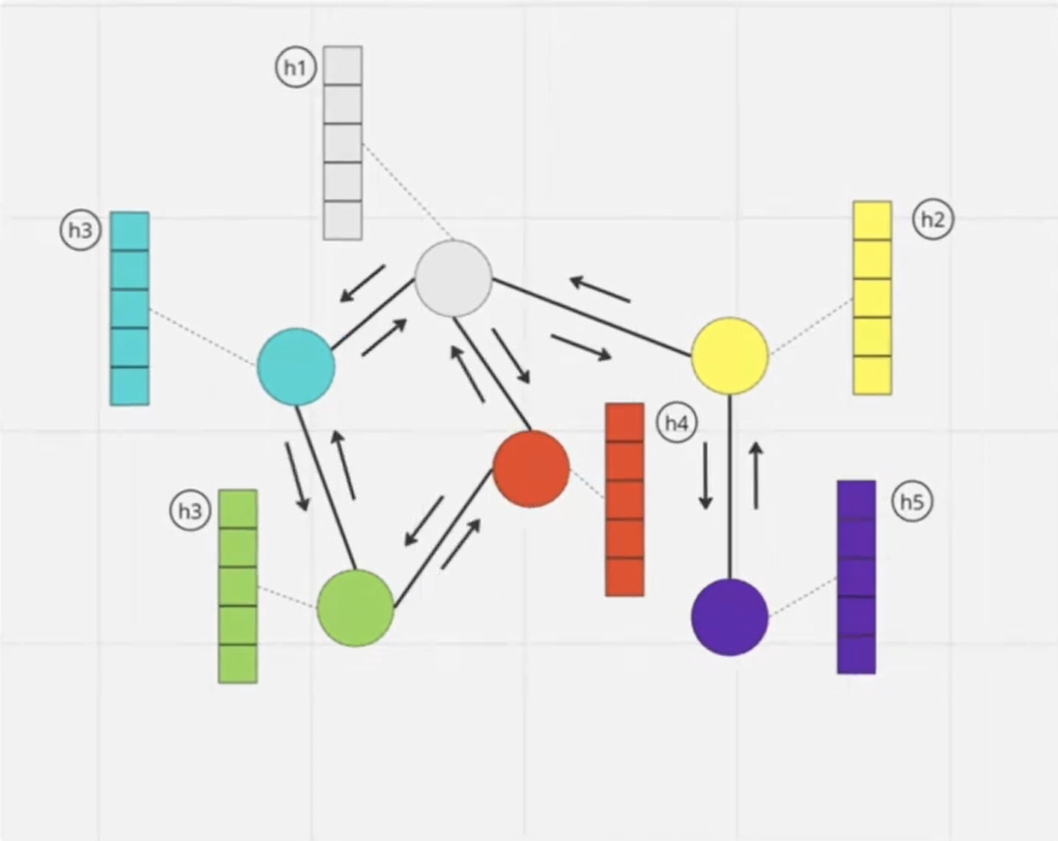
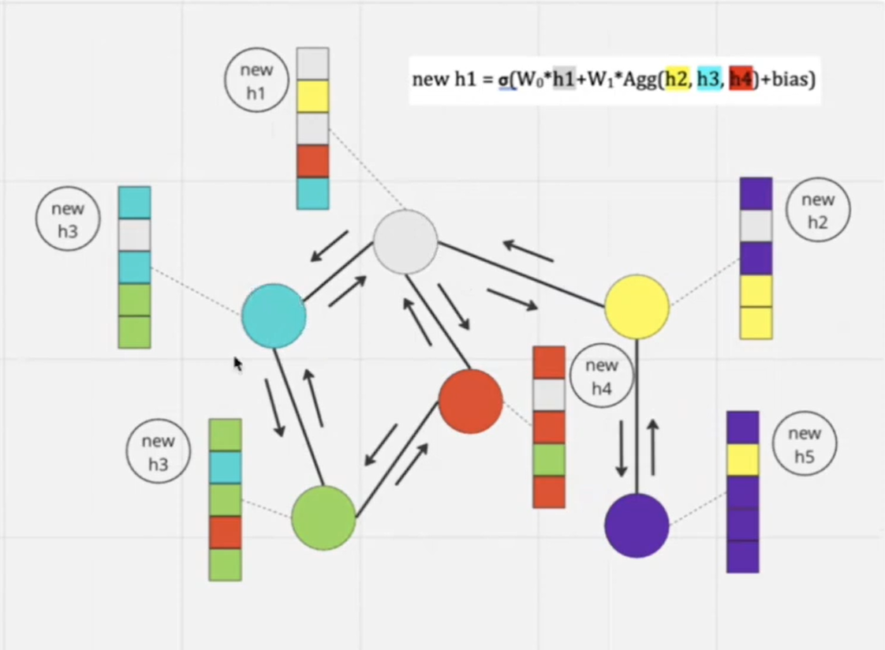
2.3 Grap Neural Networks
14
[14] Boll H. O., Lenssen N., Constantinou S. et al. Graph neural networks for clinical risk prediction based on electronic health records: a review // Journal of Biomedical Informatics. 2024. Vol. 152. URL: https://www.sciencedirect.com/science/article/pii/S1532046424000340

Slide 11
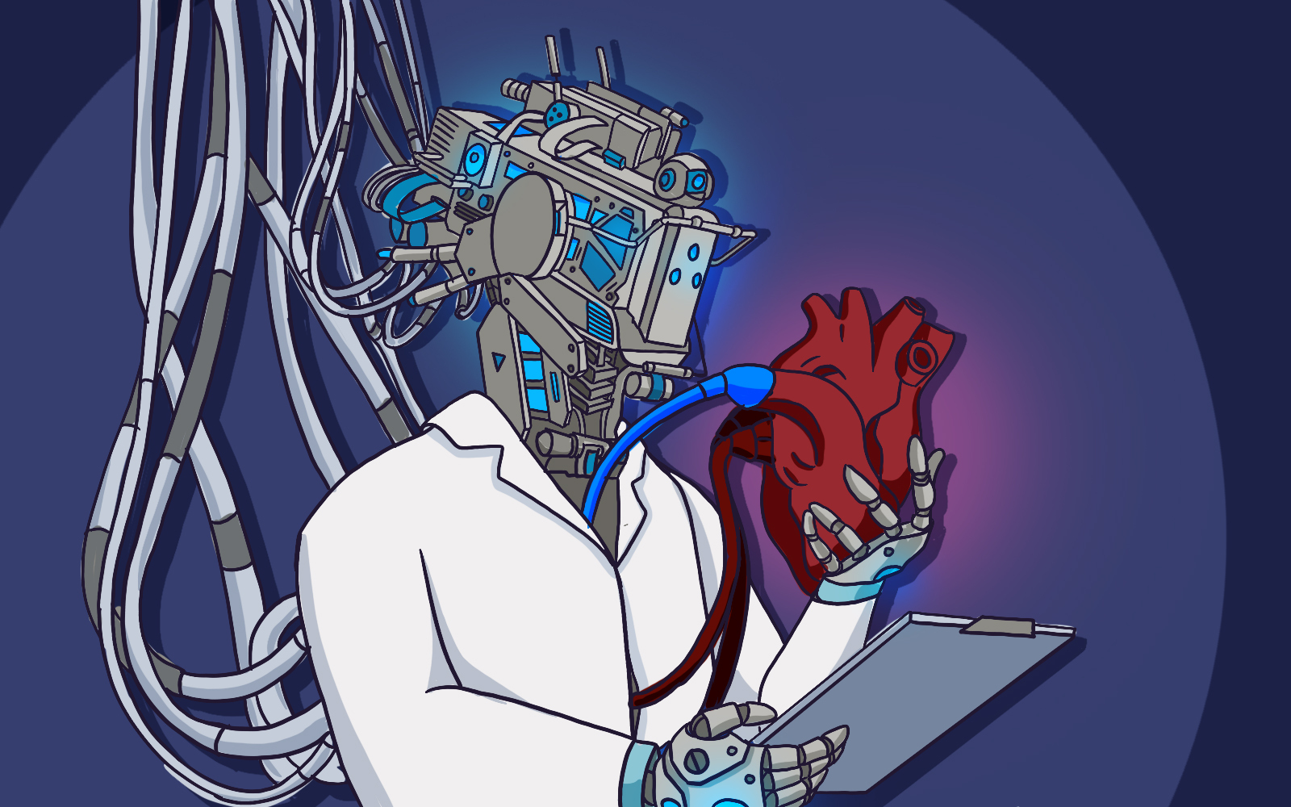
3. Технические особенности
малые и смещенные датасеты;
дисбалланс классов;
3D данные и высокая размерность;
1,2,13,6,9,11
[1] Litjens G., Kooi T., Bejnordi B. E., Setio A. A. A., Ciompi F., Ghafoorian M., van der Laak J. A. W. M., van Ginneken B., Sánchez C. I. A survey on deep learning in medical image analysis // Medical Image Analysis. 2017. Vol. 42. P. 60–88. URL: https://www.sciencedirect.com/science/article/pii/S1361841517301135 [2] Shen D., Wu G., Suk H.-I. Deep Learning in Medical Image Analysis // Annual Review of Biomedical Engineering. 2017. Vol. 19. P. 221–248. URL: https://pmc.ncbi.nlm.nih.gov/articles/PMC5479722/ [6] Albuquerque C., Henriques J., Cardoso J. S. Deep learning-based object detection algorithms in medical images: a survey // Heliyon. 2025. Vol. 11. URL: https://pmc.ncbi.nlm.nih.gov/articles/PMC11699422/ [9] Lin T.-Y., Goyal P., Girshick R., He K., Dollár P. Focal Loss for Dense Object Detection // Proceedings of the IEEE International Conference on Computer Vision. 2017. P. 2980–2988. URL: https://arxiv.org/abs/1708.02002
[11] Çiçek Ö., Abdulkadir A., Lienkamp S. S., Brox T., Ronneberger O. 3D U-Net: Learning Dense Volumetric Segmentation from Sparse Annotation // Medical Image Computing and Computer-Assisted Intervention (MICCAI). 2016. P. 424–432. URL: https://arxiv.org/abs/1606.06650 [13] Isensee F., Jaeger P. F., Kohl S. A. A., Petersen J., Maier-Hein K. H. nnU-Net: a self-configuring method for deep learning-based biomedical image segmentation // Nature Methods. 2021. Vol. 18. P. 203–211. URL: https://www.nature.com/articles/s41592-020-01008-z

Slide 12
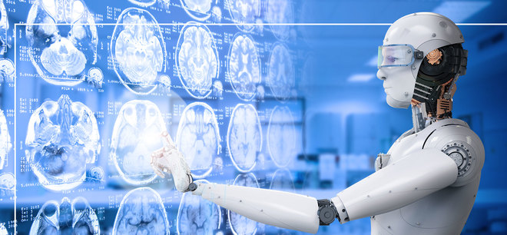
Вывод
Таким образом, выбор архитектуры в медицине определяется структурой данных и формальной постановкой задачи, а сложные клинические сценарии все чаще требуют мультимодальных моделей
[1] Litjens G., Kooi T., Bejnordi B. E., Setio A. A. A., Ciompi F., Ghafoorian M., van der Laak J. A. W. M., van Ginneken B., Sánchez C. I. A survey on deep learning in medical image analysis // Medical Image Analysis. 2017. Vol. 42. P. 60–88. URL: https://www.sciencedirect.com/science/article/pii/S1361841517301135
[5] Aburass S., Moulahcene M., Albaroudi H. et al. Vision Transformers in Medical Imaging: a Comprehensive Review of Advancements and Applications Across Multiple Diseases // BioMedical Engineering OnLine. 2025. URL: https://pmc.ncbi.nlm.nih.gov/articles/PMC12701147/
[14] Boll H. O., Lenssen N., Constantinou S. et al. Graph neural networks for clinical risk prediction based on electronic health records: a review // Journal of Biomedical Informatics. 2024. Vol. 152. URL: https://www.sciencedirect.com/science/article/pii/S1532046424000340 [16] Niu C., Wang R., Wang Y. et al. Medical multimodal-multitask foundation model for lung cancer screening // Nature Communications. 2025. Vol. 16. URL: https://www.nature.com/articles/s41467-025-56822-w

Slide 13
Список литературы
[1] Litjens G., Kooi T., Bejnordi B. E., Setio A. A. A., Ciompi F., Ghafoorian M., van der Laak J. A. W. M., van Ginneken B., Sánchez C. I. A survey on deep learning in medical image analysis // Medical Image Analysis. 2017. Vol. 42. P. 60–88. URL: https://www.sciencedirect.com/science/article/pii/S1361841517301135 [2] Shen D., Wu G., Suk H.-I. Deep Learning in Medical Image Analysis // Annual Review of Biomedical Engineering. 2017. Vol. 19. P. 221–248. URL: https://pmc.ncbi.nlm.nih.gov/articles/PMC5479722/ [3] LeCun Y., Bottou L., Bengio Y., Haffner P. Gradient-Based Learning Applied to Document Recognition // Proceedings of the IEEE. 1998. Vol. 86, No. 11. P. 2278–2324. URL: https://vision.stanford.edu/cs598_spring07/papers/Lecun98.pdf [4] Dosovitskiy A., Beyer L., Kolesnikov A. et al. An Image Is Worth 16x16 Words: Transformers for Image Recognition at Scale // International Conference on Learning Representations (ICLR). 2021. URL: https://arxiv.org/abs/2010.11929 [5] Aburass S., Moulahcene M., Albaroudi H. et al. Vision Transformers in Medical Imaging: a Comprehensive Review of Advancements and Applications Across Multiple Diseases // BioMedical Engineering OnLine. 2025. URL: https://pmc.ncbi.nlm.nih.gov/articles/PMC12701147/ [6] Albuquerque C., Henriques J., Cardoso J. S. Deep learning-based object detection algorithms in medical images: a survey // Heliyon. 2025. Vol. 11. URL: https://pmc.ncbi.nlm.nih.gov/articles/PMC11699422/ [7] Ren S., He K., Girshick R., Sun J. Faster R-CNN: Towards Real-Time Object Detection with Region Proposal Networks // Advances in Neural Information Processing Systems. 2015. URL: https://arxiv.org/abs/1506.01497 [8] Redmon J., Divvala S., Girshick R., Farhadi A. You Only Look Once: Unified, Real-Time Object Detection // Proceedings of the IEEE Conference on Computer Vision and Pattern Recognition. 2016. P. 779–788. URL: https://arxiv.org/abs/1506.02640 [9] Lin T.-Y., Goyal P., Girshick R., He K., Dollár P. Focal Loss for Dense Object Detection // Proceedings of the IEEE International Conference on Computer Vision. 2017. P. 2980–2988. URL: https://arxiv.org/abs/1708.02002 [10] Ronneberger O., Fischer P., Brox T. U-Net: Convolutional Networks for Biomedical Image Segmentation // Medical Image Computing and Computer-Assisted Intervention (MICCAI). 2015. P. 234–241. URL: https://arxiv.org/abs/1505.04597 [11] Çiçek Ö., Abdulkadir A., Lienkamp S. S., Brox T., Ronneberger O. 3D U-Net: Learning Dense Volumetric Segmentation from Sparse Annotation // Medical Image Computing and Computer-Assisted Intervention (MICCAI). 2016. P. 424–432. URL: https://arxiv.org/abs/1606.06650 [12] Oktay O., Schlemper J., Le Folgoc L. et al. Attention U-Net: Learning Where to Look for the Pancreas // arXiv. 2018. URL: https://arxiv.org/abs/1804.03999 [13] Isensee F., Jaeger P. F., Kohl S. A. A., Petersen J., Maier-Hein K. H. nnU-Net: a self-configuring method for deep learning-based biomedical image segmentation // Nature Methods. 2021. Vol. 18. P. 203–211. URL: https://www.nature.com/articles/s41592-020-01008-z [14] Boll H. O., Lenssen N., Constantinou S. et al. Graph neural networks for clinical risk prediction based on electronic health records: a review // Journal of Biomedical Informatics. 2024. Vol. 152. URL: https://www.sciencedirect.com/science/article/pii/S1532046424000340 [15] Cho H. N., Jun T. J., Kim Y. H. et al. Task-Specific Transformer-Based Language Models in Health Care: Scoping Review // JMIR Medical Informatics. 2024. Vol. 12. e49724. URL: https://medinform.jmir.org/2024/1/e49724 [16] Niu C., Wang R., Wang Y. et al. Medical multimodal-multitask foundation model for lung cancer screening // Nature Communications. 2025. Vol. 16. URL: https://www.nature.com/articles/s41467-025-56822-w

Slide 14
Спасибо за внимание!

